Slide 1
OpenNTI Collect and visualize KPI from Networks devices
Open Network Telemetry Insights
Efrain Gonzalez (efrain@juniper.net)
Pablo Sagrera (psagrera@juniper.net)
Damien Garros (dgarros@juniper.net)
Michael Pergament (mpergament@juniper.net)
Version 2.0 / Feb 16 2016

Slide 2
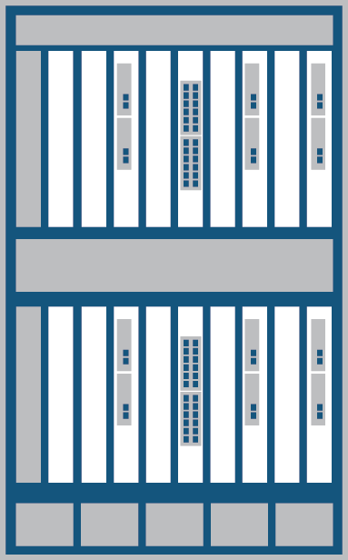



OpenNTI / Dashboard – Collector
Pre-configured with all tools and with default dashboard ..
Send it data, it will graph it
Pre defined template for Cli commands
Graphical Interface
Database
Data Streaming Collector
Data Collection Agent
Packaged with Docker, Easy to deploy, easy to maintain
Can run on server, on laptop .. on the device itself
Proof of concept Accept multiple sources of Data (Netconf/ JTI / Analyticsd / Network Agent)
Can send to multiple collector / database
MX
PTX
QFX/EX
SRX
Junos Telemetry (Jvision)
Insight Analytics
(Analyticsd)
Netconf Shell

Slide 3
Docker Deployment options
On a server
On box Guest VM
On a laptop
Docker container
Docker container
Graphical Interface
Graphical Interface
Docker container
Database
Database
Graphical Interface
Collector
Collector
Database
Collector
Guest VM w/ docker
Docker Machine
Physical or Virtual Server w/ docker
QFX10K w/ JDM
Windows or Mac laptop

Slide 4
Use cases
POC/Demo
PS/RE
Testing/Dev
Troubleshooting

Slide 5
What OpenNTI is and isn’t
What it’s
What it’s NOT
An open source project
Supported by the community
Tool to collect and graph time series data
Tool to demonstrate easily the value of telemetry
A Juniper “product”
Officially supported by Juniper (No JTAC)
A configuration management solution
An analytics solution
A replacement for CAE

Slide 6
Who’s behind this project and where is it coming from ?
SSPT QFX TME
Telefonica RE team
Graphical Interface
Graphical Interface
Damien Garros
Michael Pergament
Database
Database
Efrain Gonzalez
Pablo Sagrera Garcia
Data Streaming Collector
Data Collection Agent
Graphical Interface
Database
Data Streaming Collector
Data Collection Agent
Open NTI

Slide 7
The value of graphical representation

Slide 8
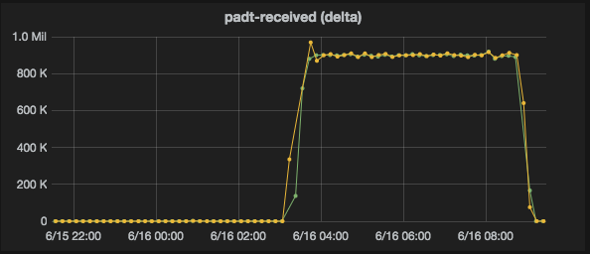
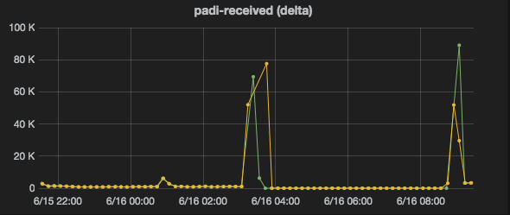
Discover how some features really works in Junos
In a BNG environment when there is a huge breakdown in the access network, a PADT and PADI storm arises.
DDOS begun to discard based on it configuration, but we found out that there is a implicit priority for PADT over PADI, so service could not be restored
So as workaround we redefined DDOS policers

Slide 9
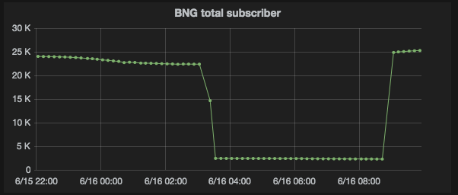
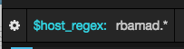
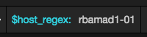
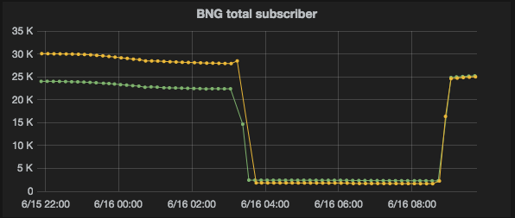
Compare same kpi on different routers using regex
Sometimes just one kpi does not tell the whole story, in this BNG scenario there was a massive problem in the access network.
If we just look one kpi on one router we could not be sure where the problem resides (access network or BNG)
If we compare same kpi among all BNG in the POP (just using a regex), we easily conclude the problem is not our BNG

Slide 10
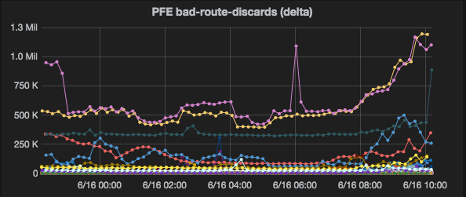
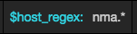
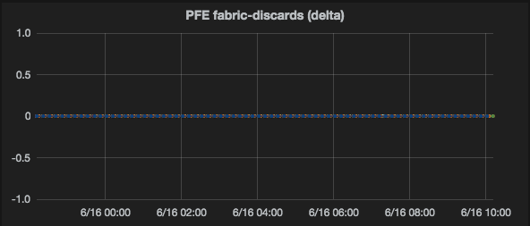
A quick overview of the whole network
In order to speed up any kind of analysis (audit or troubleshooting), first we need the ‘big picture’.
In this case using a different regex, we matched all business PE, just to confirm that although there were many ‘normal discards’ that need to be reviewed, there is NO fabric drops (a.k.a blackholing)

Slide 11
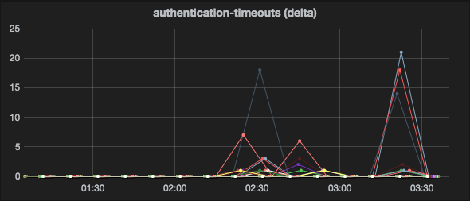
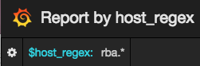
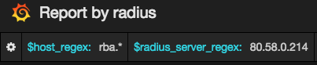
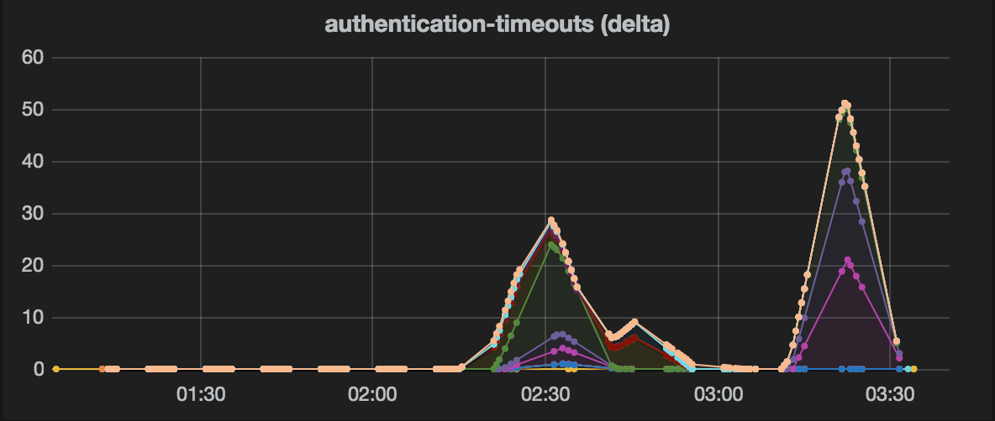
KPI analysis from different perspectives
First chart report problems in different BNGs, but so far we could not conclude anything yet, because there is anything in common.
The second chart belong to a report that shows the same kpi but in this case group by radius server.
Now we can conclude that there is a problem with just one radius server, that is having timeouts will many BNG

Slide 12
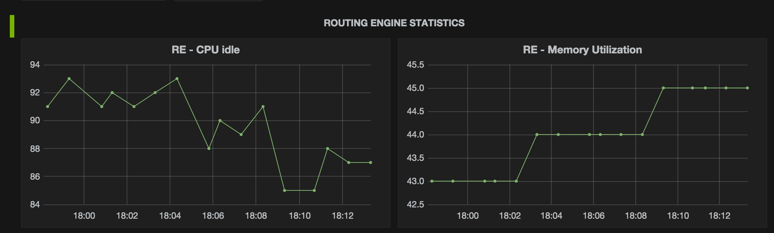
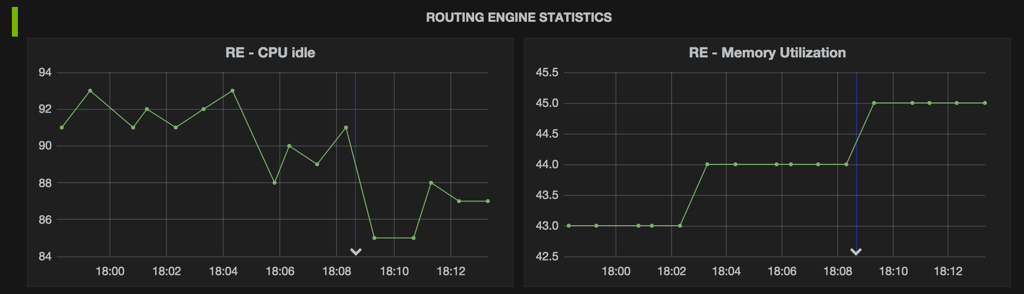
Correlate events and data
Overlay main events (Commit or Flaps) to telemetry data can quickly help to understand the root cause.

Slide 13
Components

Slide 14

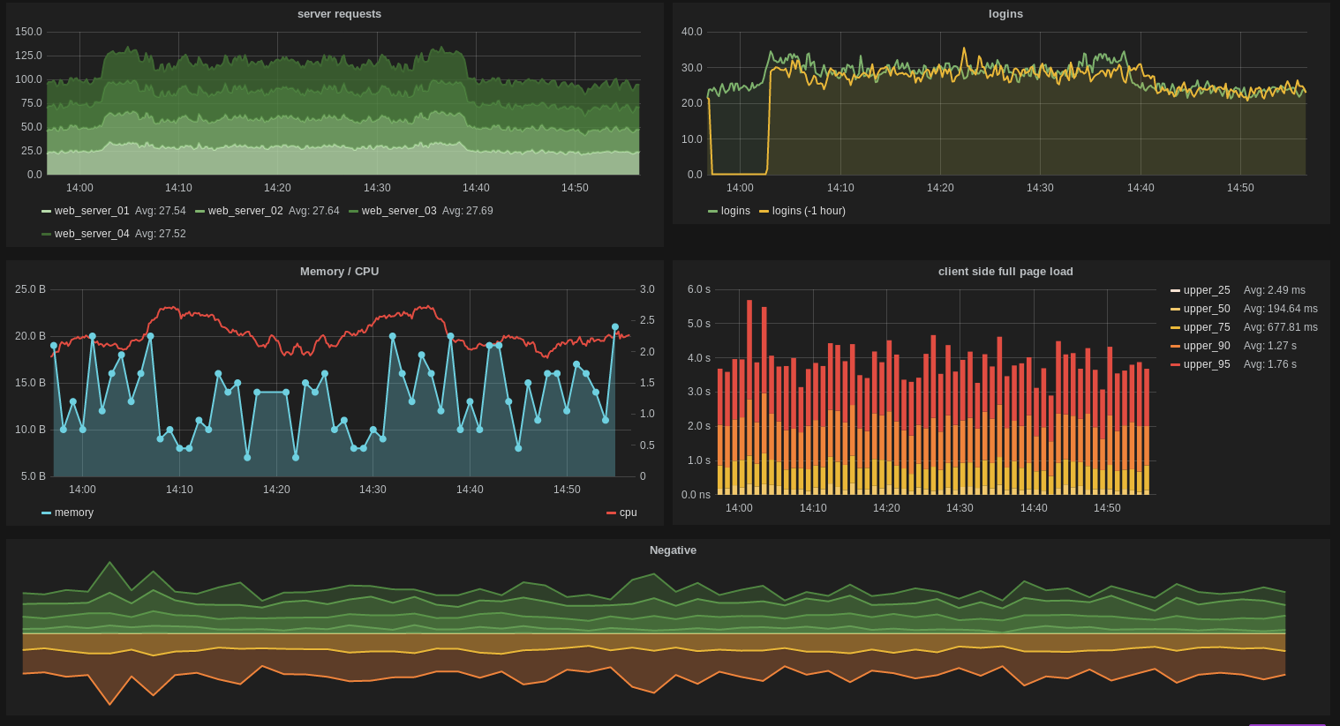
Graphical Interface – Grafana
Graphical Interface
Database
Data Streaming Collector
Data Collection Agent
Grafana provides a powerful and elegant way to create, explore, and share dashboards and data with your team and the world
Grafana supports multiple data sources: Graphite, Elasticsearch, InfluxDB, OpenTSDB, KairosDB etc
Grafana supports RestAPI

Slide 15
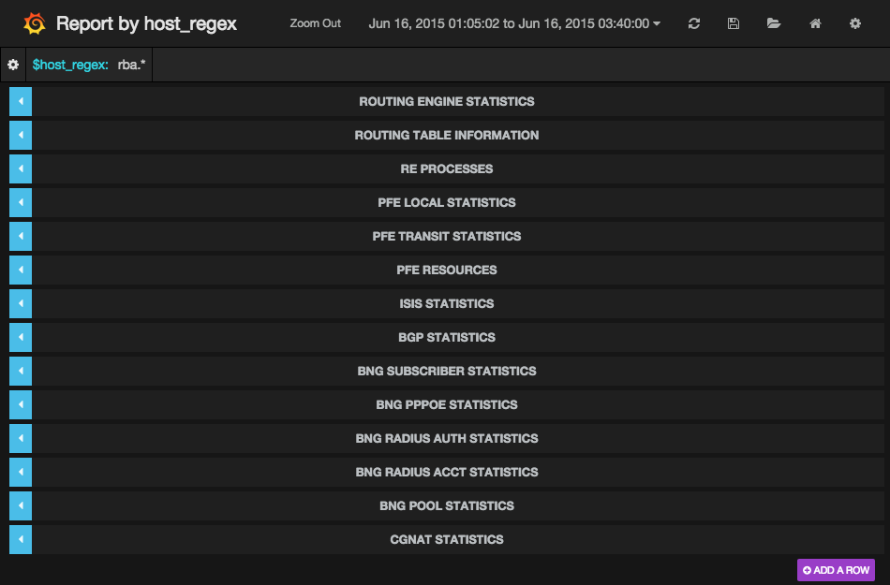
Graphical Interface - Grafana
Graphical Interface
Database
1
3
Data Streaming Collector
Data Collection Agent
2
Report Name
Regex filter
Time range
KPI are organized by sections
4

Slide 16
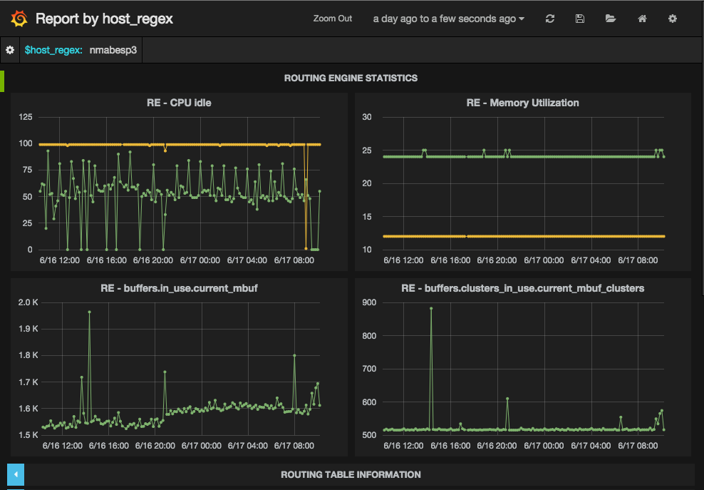
J-Oracle Web UI: Grafana
Graphical Interface
Database
Data Streaming Collector
Data Collection Agent
1
Expand the report section by clicking on it title
Each graph represent a query to the DB
2

Slide 17
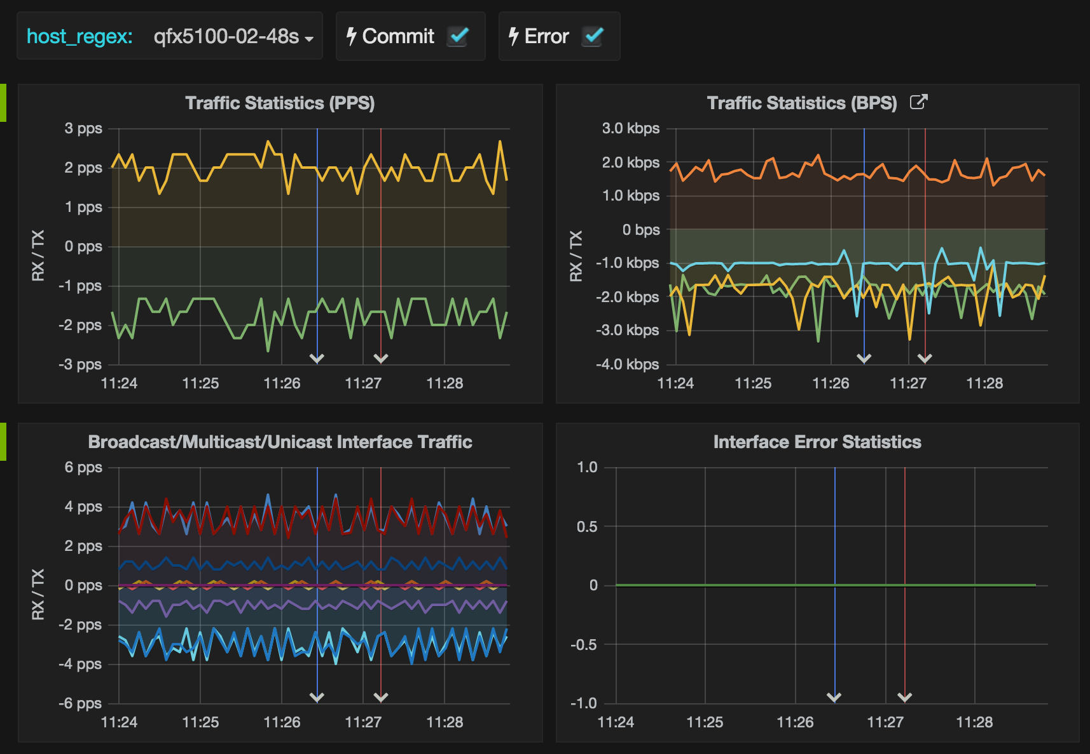
J-oracle Web UI: Grafana
Graphical Interface
Database
Data Streaming Collector
Data Collection Agent
2
1
Overlay events on top of your data
In this example :
Commit are represented in Blue
Error are represented in Red
Events can be added :
With a syslog message
With a REST call (shell, Ansible, Junos)

Slide 18
Database – Influxdb
Graphical Interface
Database
Data Streaming Collector
Data Collection Agent
Open Source time series database
Written in Go
Store time series data and events down to ms accuracy
Schema less
Data are stored with “tags”
Design to scale-out within a cluster
Very popular since 2014
Natively expose a full REST API (read/write)
https://github.com/influxdata

Slide 19


Data Streaming Collector – Fluentd
Graphical Interface
Database
Data Streaming Collector
Data Collection Agent
Database Influxdb
Fluentd accept different type of streaming data from MX, PTX, QFX & EX :
Junos Telemetry (GPB/UDP)
Analyticsd (JSON/UDP)
Network Agent (JSON/UDP)
output_plugin fluent-plugin-influxdb
Key/value Format : structured
input_plugin fluent-plugin-juniper-telemetry
50000/UDP
50010/UDP
50010/UDP
Junos Telemetry
(Jvision) GPB/UDP
Network Agent
JSON/UDP
Analyticsd
JSON/UDP
Data are converted into Key/Value pairs and injected into Influxdb as “tags”
MX
QFX10000
QFX5200
QFX5100
EX4300

Slide 20
Fluentd plugins used
Fluent-plugin-juniper-telemetry
Fluent-plugin-influxdb
This plugin include 3 input parsers and 3 output-format
Input Parser :
Juniper_jti - default on port 50000/UDP
Juniper_na - default on port 50010/UDP
Juniper_analyticsd - default on port 50020/UDP
Output_format :
Structured - Compatible with Influxdb plugin
Flat - Compatible with Graphite plugin
Statsd
Accept data in Structured format
Push data to influxdb over HTTP using tags
Integrate a buffer, by default send data out every 5 seconds
https://github.com/JNPRAutomate/fluent-plugin-juniper-telemetry
https://github.com/fangli/fluent-plugin-influxdb

Slide 21




Data Collection Agent – PyEZ
Graphical Interface
Database
Data Streaming Collector
Data Collection Agent
Database
Data Collection Agent
Collect information over CLI or Shell Compatible with all Junos devices and third party
Information collected either in XML or in Text
Devices are classified using “tags”
Leverage a collection of “parser”
PYEZ
Devices list Commands list
Netconf Shell
MX
PTX
QFX/EX
SRX
Written in Python leveraging PyEZ library
Tested with 9k KPI / min from 450 routers

Slide 22
Data Collection Agent – PyEZ
Graphical Interface
Database
Data Streaming Collector
Data Collection Agent
Classify devices by tags
Use tags to
mx-edge011: edge mx madrid bgp mpls
mx-edge012: edge mx madrid bgp mpls
mx-edge021: edge mx munich bgp mpls
mx-edge022: edge mx munich bgp mpls
mx-agg011: agg mx madrid bgp isis
mx-agg012: agg mx madrid bgp isis
qfx-agg021: agg qfx munich bgp
qfx-agg022: agg qfx munich bgp
qfx5100-01: tor qfx madrid isis
qfx5100-02: tor qfx madrid isis
Define credentials
simple_cred:
username: simple
password: mytor
community: mytor
tags: tor
secure_cred:
username: root
password: myedge123!?=
community: edge123!?=
tags: edge agg
Define commands to execute
base_command:
commands: |
show system processes extensive
show chassis routing-engine | display xml
tags: agg edge tor
bgp_commands:
commands: |
show route summary | display xml
show bgp summary | display xml
tags: bgp
By role
By type
By location
By feature

Slide 23
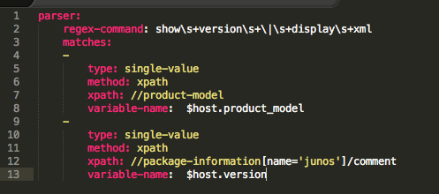
Data Collection Agent - Parser
In order to extract KPIs from a junos command output, a related ‘parser’ must exist before.
There are parsers for xml and for non-xml output (using regex)
Below there is an example parser for ‘show version | display xml’ command.
This parser extract 2 values (the product-model and the version)
show-version.parser.yaml
The regex-command relates the parser with the executed command
The xpath to be execute to extract the KPI
The KPI will be stored in the DB under the variable with this name.
1
2
3

Slide 24
Interact with OpenNTI in a programmatic way

Slide 25
Programmatic interfaces
Grafana - REST Interface
The GUI has a REST interface available that can be used to publish dashboard automatically.
A dashboard is just a JSON file
It’s possible to generate Dashboard from Ansible and publish them automatically
REST
Graphical Interface - Grafana
REST
Database – Influxdb
Influxdb - REST Interface
Data Streaming Collector
Data Collection Agent
The database has a REST interface what allow anyone to push or access data.

Slide 26
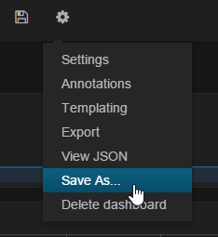
How to automate creation of dashboards?
Dashboards can be imported/exported
Format is JSON
Dashboard creation is part of the same Ansible project which is used to automate Junos analytics configuration on Junos devices
RestAPI is used to push generated dashboards to Grafana

Slide 27
Contribute and Participate

Slide 28
Projects open to contribution
Open NTI
https://github.com/Juniper/open-nti
[Public] Fluentd plugin
https://github.com/JNPRAutomate/fluent-plugin-juniper-telemetry
[Public] Capture file replay
https://github.com/dgarros/docker-tcpreplay
How can you contribute
Improve documentation
Report issue
Improve dashboard
Add command parser
Suggest enhancement
Write code/plugin
Contribution is not just about code

Slide 29
Thank You

Slide 30
Backup slides / Screenshots

Slide 31
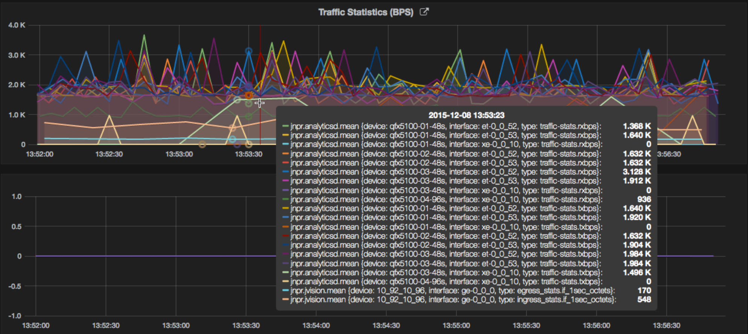
Grafana Default Dashboard, BPS Stats example

Slide 32
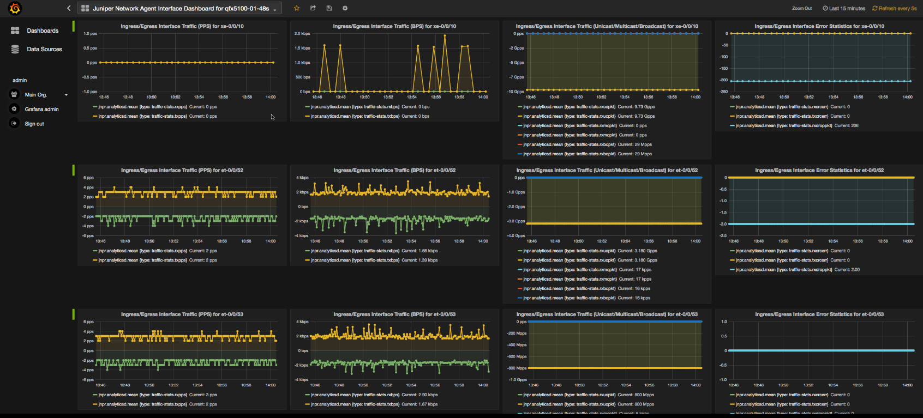
Interface Dashboard For Single Device

Slide 33
ASIC Dashboard for Single Device

